Slide 1
Final Year Research Project
Saul Vassallo

Slide 2
Creating a Custom Dataset and AI Model for predicting Sail Deformations: Integrating Computer Vision for data extraction and machine learning for predictive analysis

Slide 3
Why this project
01
Table of contents
02
Project Overview
Computer Vision
03
What is the problem?
Data Extraction

Slide 4
Providing a proof of concept:
Automated sail shape extraction
Real time sail deformation prediction

Slide 5
Project Overview
Build a dataset from scratch by tracking sail inputs while sailing and taking images of the sail with these inputs.
Develop a computer vision pipeline to automatically extract numerical sail shape from collected images.
Use dataset and extracted sail shape to train a fully connected neural network to predict sail deformations in real time.

Slide 6
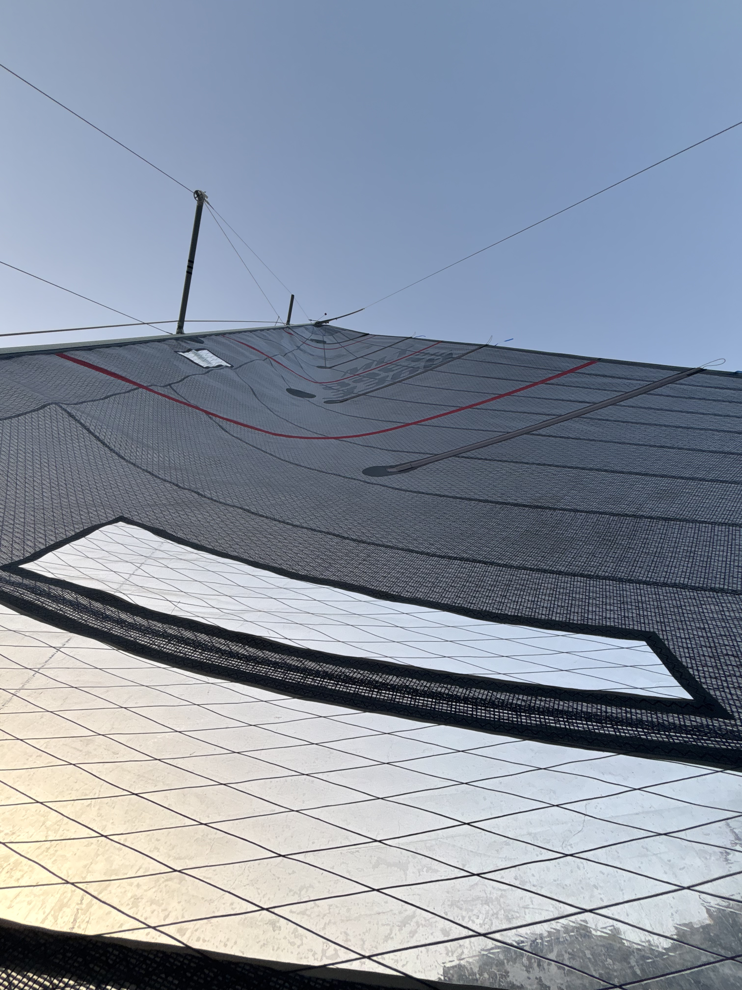
Computer Vision Pipeline
Inspired by a paper I read about detecting road
lanes using image processing [1].
Ends up being a balancing act between successful pixel detection and too much noise.

Slide 7
Point and Area processing
Edge detection and Selection
Colour thresholding in HSV space.
Greyscale conversion.
Gaussian blurring.
Dilation and erosion.
Detecting all edges only in a certain area of the image.
Selecting the 3 splines based off of a few conditions regarding edge length.

Slide 8
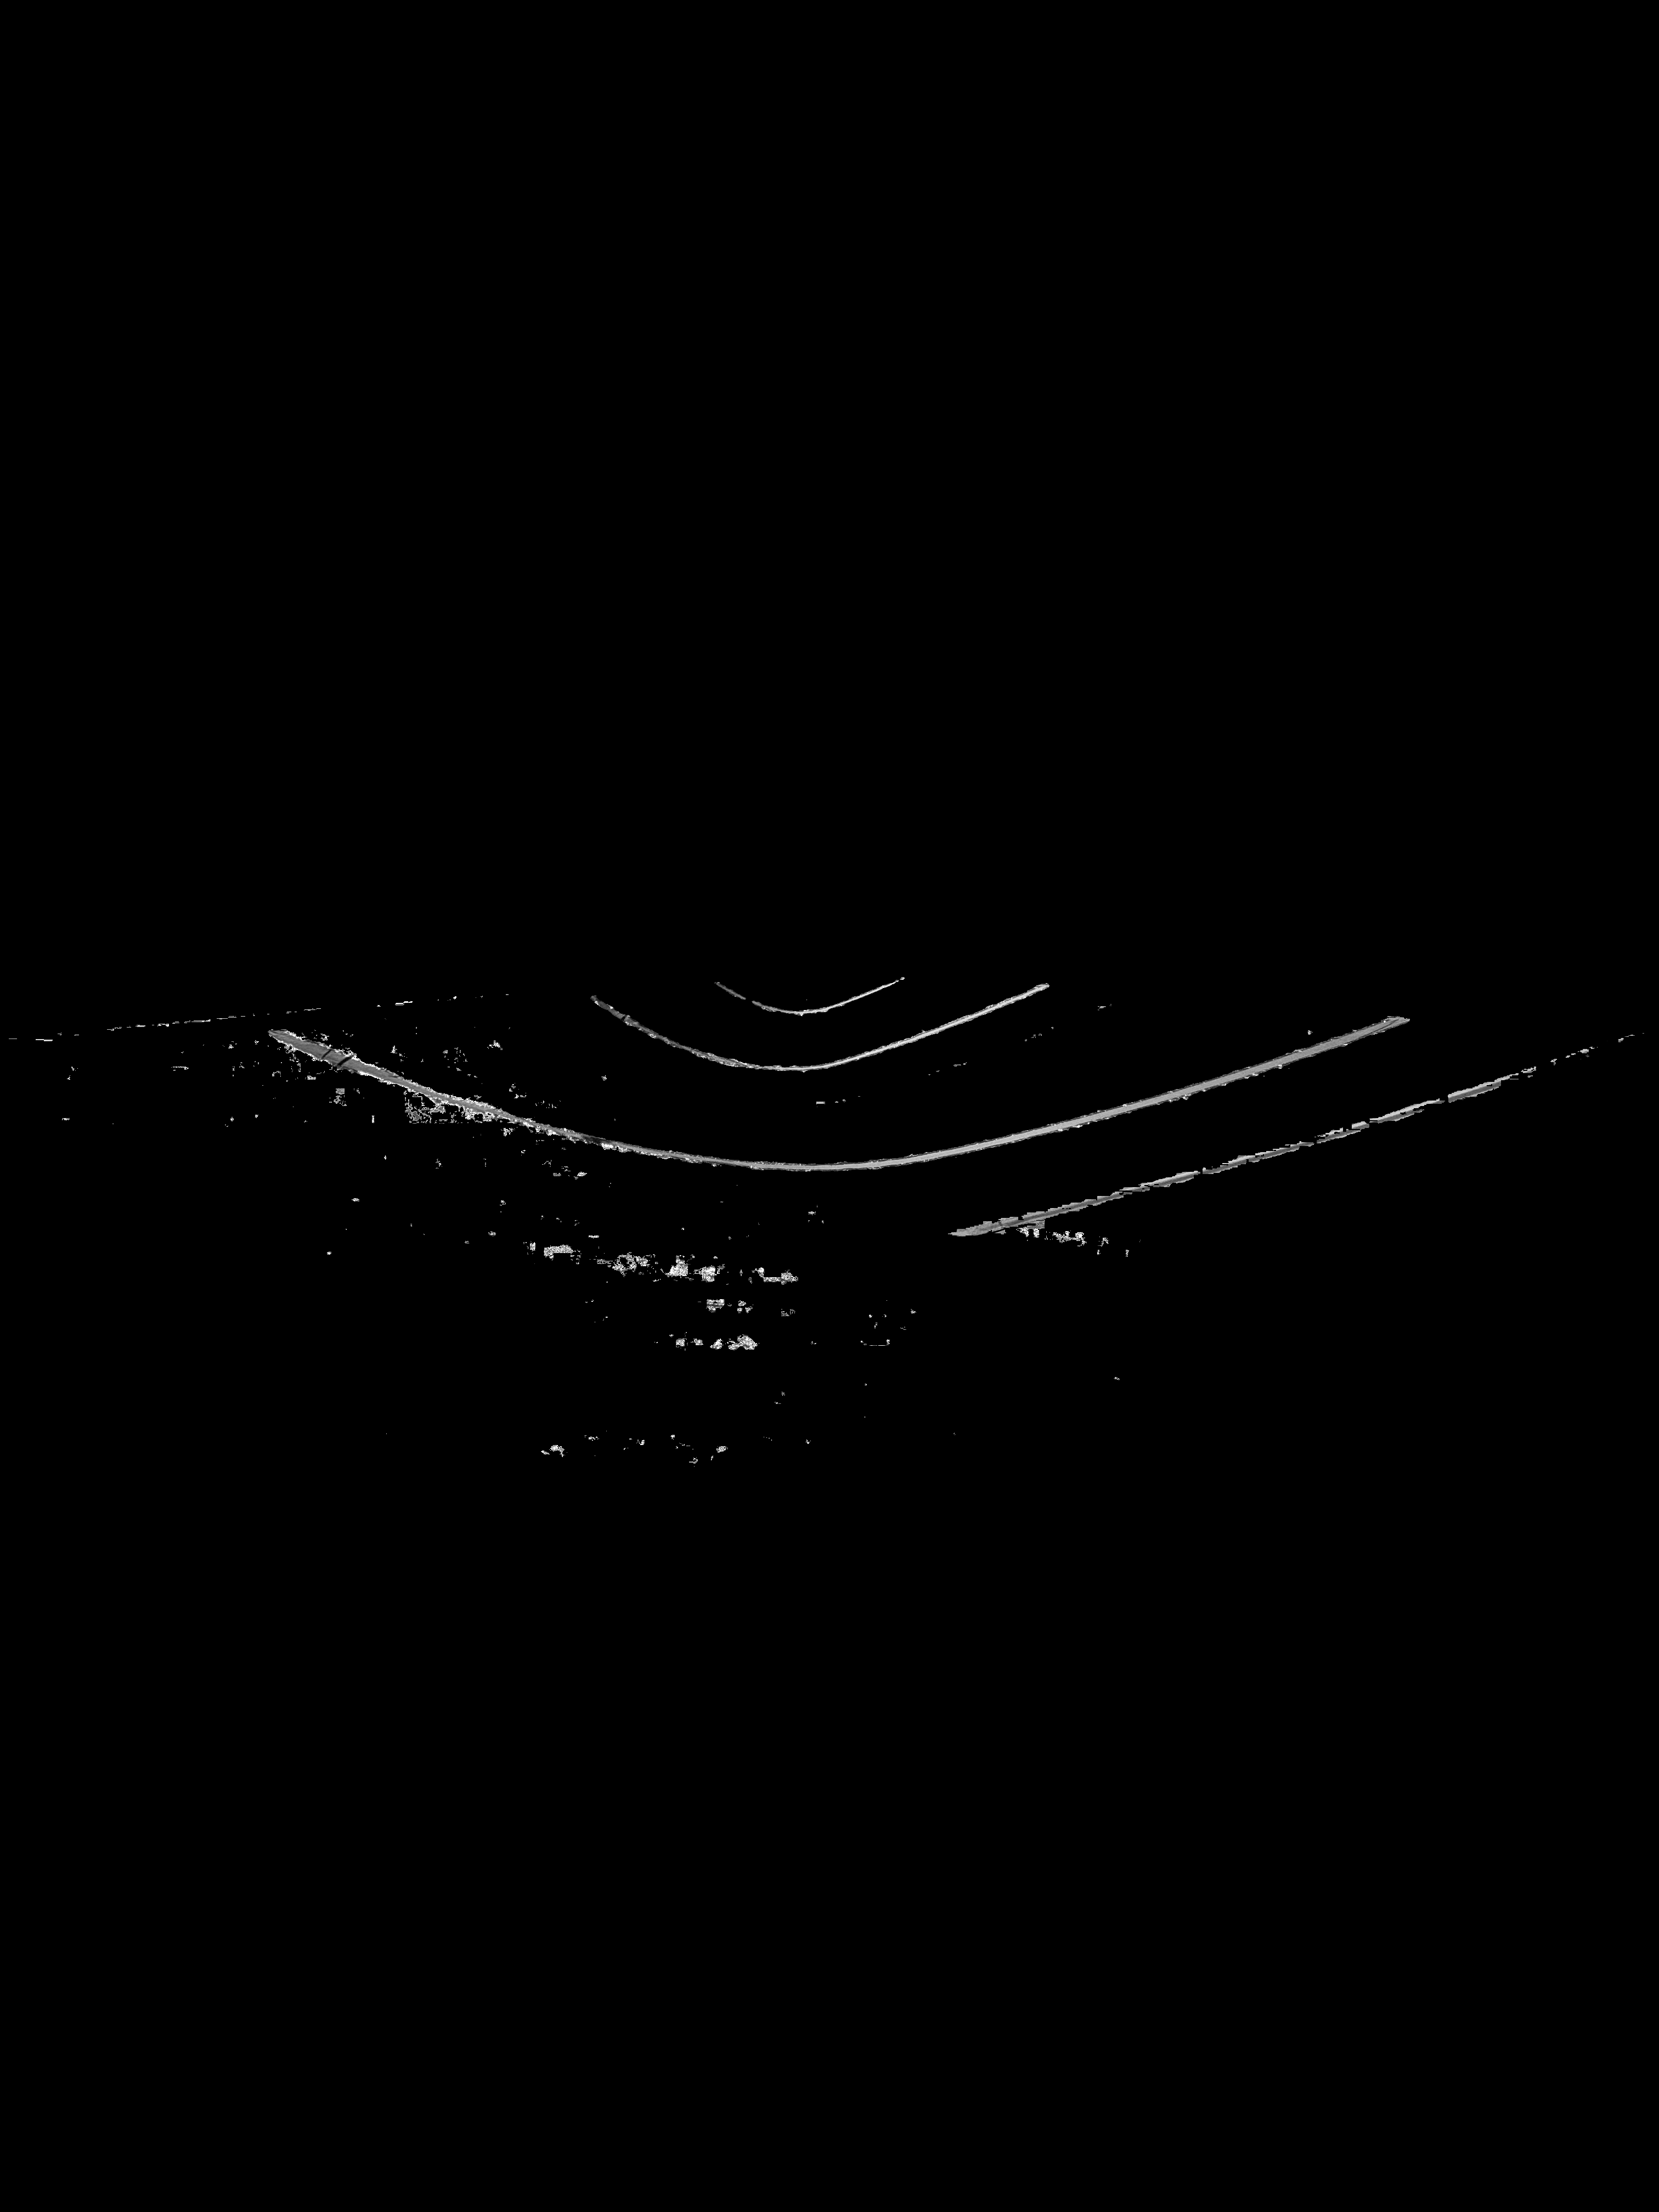

Pixel Thresholding
Due to lighting inconsistencies leads to small gaps in the splines and a little bit of noise.

Slide 9

Blurring
Smoothen the edges

Slide 10

Dilation
Filling in spline gaps
Introduces some noise

Slide 11
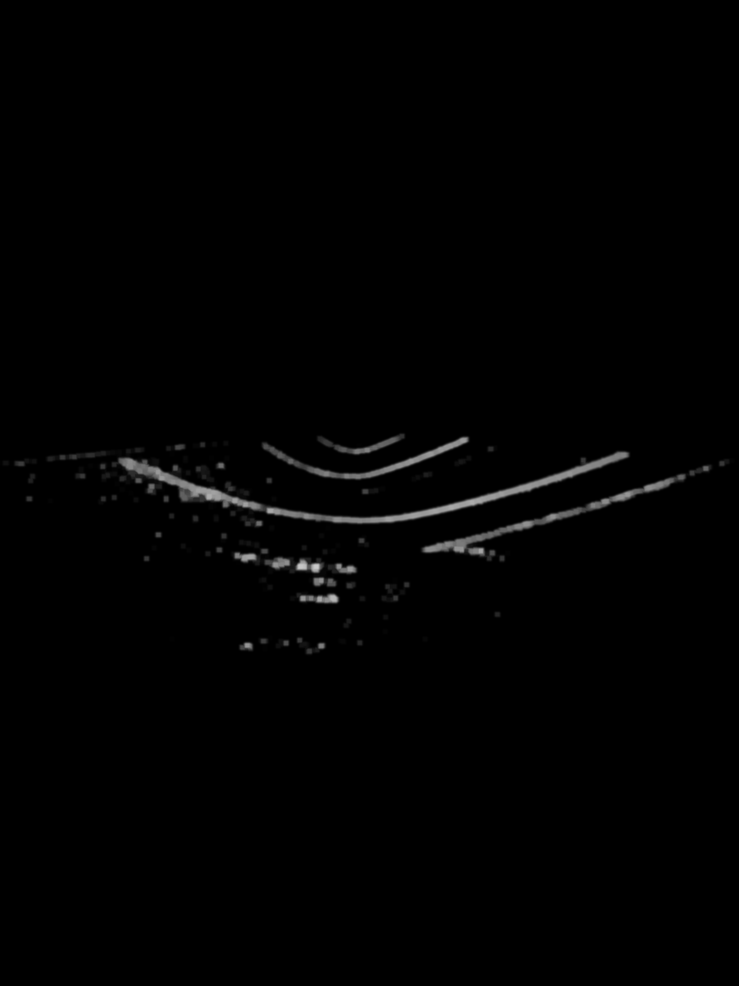
Erosion
Reduce noise while keeping splines connected

Slide 12

Edge Detection
Finding all edges

Slide 13
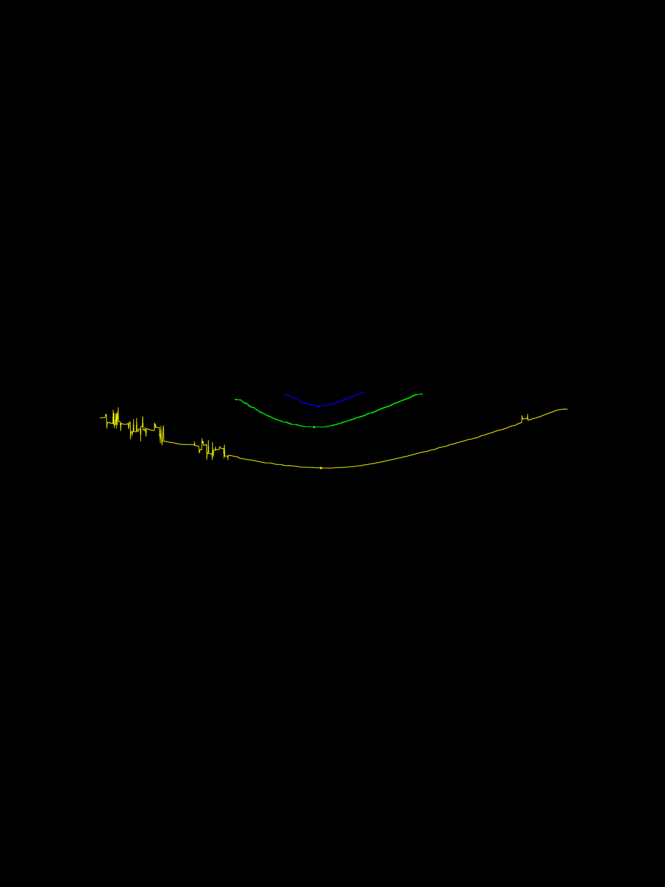
Edge Selection
Selecting the correct edges and flattening them.

Slide 14
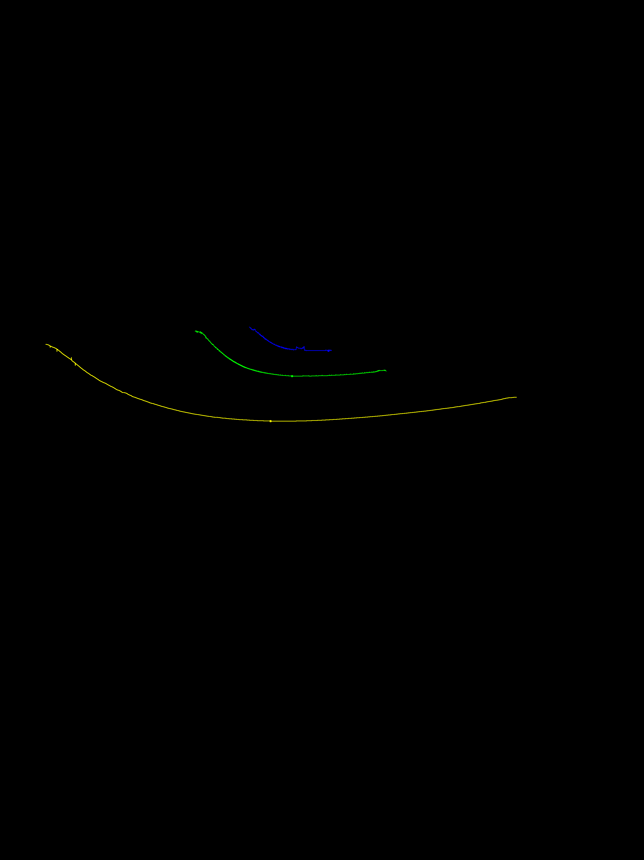
Overlays
Bad lighting
Good lighting

Slide 15
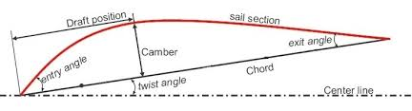
TCD Extraction
Extraction of numerical sail parameters from splines

Slide 16
[1] V. Devane, G. Sahane, H. Khairmode, and G. Datkhile, “Lane Detection Techniques using Image Processing,” ITM Web of Conferences, vol. 40, p. 03011, Aug. 2021, doi: https://doi.org/10.1051/itmconf/20214003011.
References

